Slide 1
Object Recognition with Traditional Models
COMP 4447 Midterm Presentation
Jian Sun

Slide 2
Introduction
Focus
Evaluating traditional machine learning models for image recognition tasks using CIFAR-10.
Approach
Comparing performance and limitations of Support Vector Classifier and Random Forest models
Objective
Understand how traditional models can remain competitive in data-scarce scenarios.

Slide 3
Goal of the Study Understanding Traditional Models for Object Recognition
Primary Inquiry
Can traditional models effectively perform object recognition in small-data scenarios?
Comparison Focus
Evaluate how traditional models perform relative to deep learning methods.
Practical Implications
Identify scenarios where traditional approaches are advantages.

Slide 4
Problem Statement Challenges in Real-World Applications of Deep Learning
Data Limitation
Typical real-world datasets are small, unlike massive datasets required by deep learning.
Resource Constraints
Deep learning models demand high computational power often unavailable in constrained settings.
Relevance of Traditional Models
Traditional models remain practical under data and resource limitations.

Slide 5
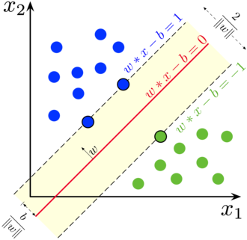
Research Objective Investigating Traditional Models in Object Recognition
Capability Analysis: Examine whether traditional models can effectively learn visual features.
Limitations Study: Identify specific challenges preventing traditional models from matching deep learning.
Performance Benchmarking: Measure classification accuracy using CIFAR-10 for SVC and RFC.

Slide 6
Selected Models Support Vector Classifier and Random Forest Classifier
Support Vector Classifier (SVC)
Finds optimal hyperplanes in high-dimensional space to separate classes.
Random Forest Classifier (RFC)
Ensemble of decision trees trained on random subsets to improve generalization.
Selection Rationale
These models are interpretable, computationally efficient, and require less data.

Slide 7

Model Details
Support Vector Classifier (SVC)
SVC uses kernel function (e.g. Radial Basis Function, polynomial) to do field transformation for linear separation.
$$\frac{1}{2}{\left|\left|w\right|\right|}^{2}+C\sum_{i=1}^{n}{ξ_{i}}$$
SVC uses kernel function (e.g. Radial Basis Function, polynomial) to do field transformation for linear separation.
𝟏/𝟐 |(|𝒘|)|^𝟐+𝑪∑_(𝒊=𝟏)^𝒏▒𝛏_𝐢
Random Forest Classifier (RFC)
RFC follows three steps:
bootstrap sampling for each tree
randomized construct each tree (maximizes information gain or entropy to split each node)
majority voting for prediction

Slide 8
Dataset Overview: CIFAR-10 Canonical Dataset for Object Classification
Dataset Size
60,000 color images in 10 classes with 6,000 images per class.
Image Format
Each image is 32x32 pixels with 3 RGB channels.
Purpose
Widely used for benchmarking object recognition models.

Slide 9
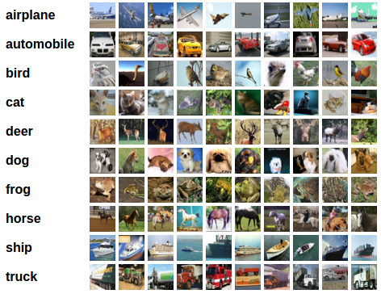
Sample Images from CIFAR-10 10 Object Class Visualized
Animal Classes: Includes bird, cat, deer, dog, frog, horse.
Vehicle Classes: Includes airplane, automobile, ship, truck.
Class Balance: Each class has an equal number of images: 6,000.

Slide 10
Data Preprocessing Enhancing Image Input Quality
Augmentation Techniques
Random rotation (+-20º), flipping, and Gaussian noise added to boost robustness.
Normalization
Applied z-score normalization after flattening images from 3D to 1D.
Goal of Preprocessing
Increase generalization and reduce overfitting for traditional classifiers.

Slide 11
Experimental Design
Train model on Apple M3 CPU
Tune Hyperparameters in ablation studies

Slide 12
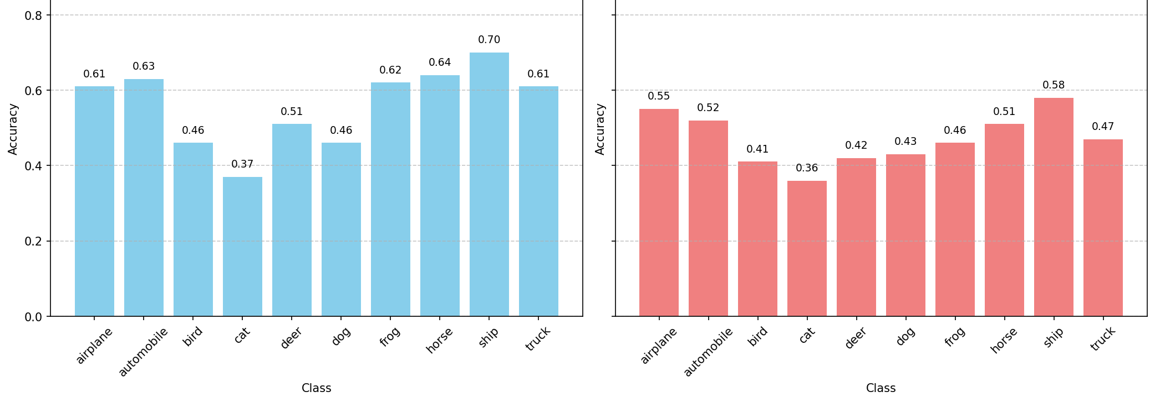
Experimental Results 1
SVC accuracy: 56.03%
RFC accuracy: 47.12%
Ship is easier to predict than others
Notes:
SVC achieved 56.03% accuracy, around 10% higher than RFC’s result, 47.12%. Hence, SVC performs better than RFC on the CIFAR-10 dataset.

Slide 13
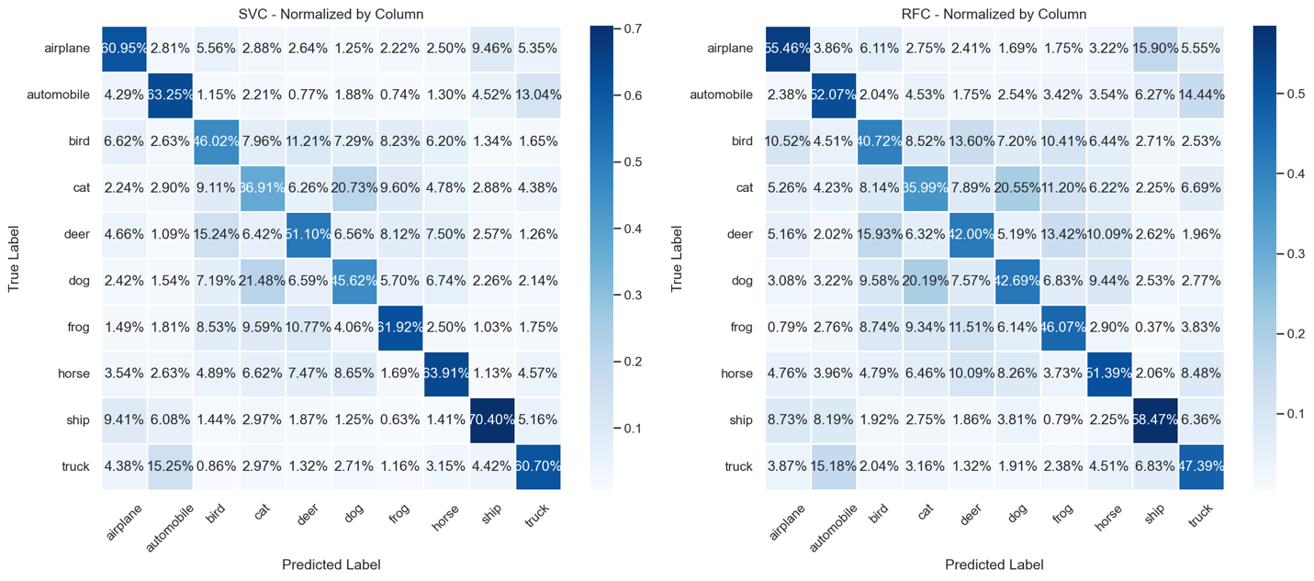
Experimental Results 2
vehicles are easier to predict than animals
Notes:
SVC achieved 56.03% accuracy, around 10% higher than RFC’s result, 47.12%. Hence, SVC performs better than RFC on the CIFAR-10 dataset.

Slide 14
Experimental Results 3
Traditional model is less competitive than SOTA deep learning models, due to its weak representative capability.
Model | Accuracy
ViT-H/14 (Dosovitskiy, 2020) | 99.50%,
DINOv2 (Oquab, 2023) | 99.50%,
SVC (Ours) | 56.03%
RFC (Ours) | 47.12%
Notes:
SVC achieved 56.03% accuracy, around 10% higher than RFC’s result, 47.12%. Hence, SVC performs better than RFC on the CIFAR-10 dataset.

Slide 15
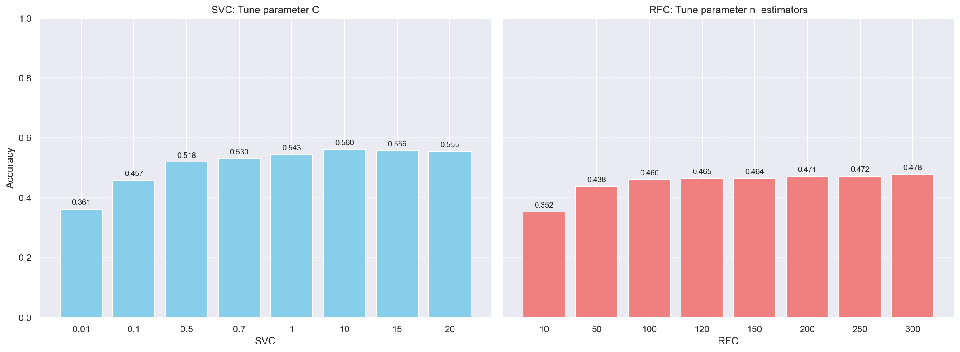
Ablation Study
1 Study the effectiveness of C on SVC performance
C = [0.01,0.1,0.5,0.7,1,10, 15]
best at C=10
2 Study the effectiveness of number of estimators on RFC performance
n_estimators = [10,50,100,120,150,200,250,300]
best at n_estimators= 300
Tune C and n_estimators
Notes:
SVC achieved 56.03% accuracy, around 10% higher than RFC’s result, 47.12%. Hence, SVC performs better than RFC on the CIFAR-10 dataset.

Slide 16

Discussion
Deep learning models extract much richer features by more convolved structure.
SVC and RFC only extract rare features by simple structure, impossible for reaching extremely good performance.
Feature richness drives performance differences of traditional models and deep learning ones.
Traditional models are stable and efficient but weak at feature extraction.
Notes:
Deep learning models (ViT‑H/14, DINOv2) achieve 99.5% SOTA results with 632M and 1.1B tunable parameters.
SVC and RFC reach 56.03% and 47.12% accuracy by possessing 5 (C, kernel, gamma, etc) and 10+ (n_estimators, max_depth, max_features, min_samples_split, min_samples_leaf, etc.) tunable parameters.

Slide 17
Conclusion
SVC & RFC extract insufficient features → mediocre accuracy
1
SVC & RFC’s stability shows efficiency in learned representations
2

Slide 18
Future Work
Improve representative learning in deep models
Enrich feature variations for traditional models
Traditional models focus on structured data rather than complex data modalities like video, audio, and images.
Maintaining stable performance on few-shot datasets

Slide 19

Q&A
Thank you

